Slide 1

USER AUTHENTICATION
Network Security

Slide 2
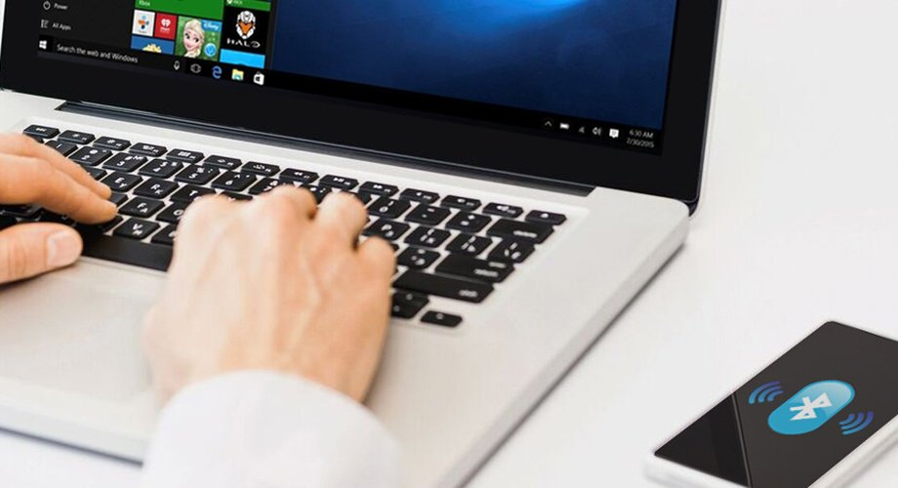
Definition of user authentication
User authentication is a process that allows a device to verify the identify of someone who connects to a network resource. There are many technologies currently available to a network administrator to authenticate users.
User authentication is a technique to validate or verify a human-to-machine data or information transfer to establish the authenticity of the concerned individual.
Notes:
User authentication is a process that allows a device to verify the identify of someone who connects to a network resource. There are many technologies currently available to a network administrator to authenticate users.
User authentication is a technique to validate or verify a human-to-machine data or information transfer to establish the authenticity of the concerned individual.

Slide 3

Importance in Network Security
Authentication is important because it enables organizations to keep their networks secure by permitting only authenticated users (or processes) to access its protected resources, which may include computer systems, networks, databases, websites and other network-based applications or services.
With functional User-Authentication features on-board, an organization can keep security breaches at bay and can concentrate better on the cloud-specific features
Notes:
Authentication is important because it enables organizations to keep their networks secure by permitting only authenticated users (or processes) to access its protected resources, which may include computer systems, networks, databases, websites and other network-based applications or services.
With functional User-Authentication features on-board, an organization can keep security breaches at bay and can concentrate better on the cloud-specific features

Slide 4

Kerberos
Kerberos V5 is based on the Kerberos authentication system developed at MIT. Under Kerberos.
A client (generally either a user or a service) sends a request for a ticket to the Key Distribution Center (KDC). The KDC creates a ticket-granting ticket (TGT) for the client, encrypts it using the client's password as the key, and sends the encrypted TGT back to the client.
Notes:
Kerberos V5 is based on the Kerberos authentication system developed at MIT. Under Kerberos.
A client (generally either a user or a service) sends a request for a ticket to the Key Distribution Center (KDC). The KDC creates a ticket-granting ticket (TGT) for the client, encrypts it using the client's password as the key, and sends the encrypted TGT back to the client.

Slide 5

Kerberos pertinent standards
Configuration
Alice (human) uses secure terminals with no user-related information to access resources over insecure network.
Bob (application server) holds the resources
Alice uses KDC to authenticate herself to Bob
Notes:
Configuration
Alice (human) uses secure terminals with no user-related information to access resources over insecure network.
Bob (application server) holds the resources
Alice uses KDC to authenticate herself to Bob

Slide 6

Kerberos pertinent standards
Terms
Principal – a user or resource that use Kerberos
Master key – a long-term secret shared between KDC and each principal
KDC is also known as Authentication Server (AS) and Ticket Granting Server (TGS), has the database of secrets for the principals, encrypted for security (why?) with KDC’s master key (that KDC shares with no one “for now”)
Authenticator – a timestamp encrypted by a key: proves the receiver that the sender knows the key
• Clocks in network need to be somewhat synchronized
• Servers tolerate clock skew (about 5mins)
Notes:
Terms
Principal – a user or resource that use Kerberos
Master key – a long-term secret shared between KDC and each principal
KDC is also known as Authentication Server (AS) and Ticket Granting Server (TGS), has the database of secrets for the principals, encrypted for security (why?) with KDC’s master key (that KDC shares with no one “for now”)
Authenticator – a timestamp encrypted by a key: proves the receiver that the sender knows the key
• Clocks in network need to be somewhat synchronized
• Servers tolerate clock skew (about 5mins)

Slide 7

Microsoft's implementation of Kerberos
Kerberos is complicated. Windows hides a lot of that complexity. This makes it easy to spin up Windows Domains, but can become a nightmare for the Windows Server administrator when things are not working.
Notes:
Kerberos is complicated. Windows hides a lot of that complexity. This makes it easy to spin up Windows Domains, but can become a nightmare for the Windows Server administrator when things are not working.

Slide 8

Microsoft's implementation of Kerberos
Windows 2000 and later uses Kerberos as its default authentication method. Some Microsoft additions to the Kerberos suite of protocols are documented in RFC 3244"Microsoft Windows 2000 Kerberos Change Password and Set Password Protocols". RFC 4757 documents Microsoft's use of the RC4 cipher. While Microsoft uses and extends the Kerberos protocol, it does not use the MIT software
Notes:
Windows 2000 and later uses Kerberos as its default authentication method. Some Microsoft additions to the Kerberos suite of protocols are documented in RFC 3244"Microsoft Windows 2000 Kerberos Change Password and Set Password Protocols". RFC 4757 documents Microsoft's use of the RC4 cipher. While Microsoft uses and extends the Kerberos protocol, it does not use the MIT software

Slide 9
Microsoft's implementation of Kerberos
When logging into a Windows instance (server or workstation, hardware or virtual machine) that is not connected to a domain, then you are performing a local logon (using NTLM and authenticating against a local user database). If it is connected to a domain, then a domain logon is being performed (it will use Kerberos, by default). For domain logons, the user database is on the domain controller. Even if the Windows instance is attached to a domain, there is still an option to log into the local OS.
Notes:
When logging into a Windows instance (server or workstation, hardware or virtual machine) that is not connected to a domain, then you are performing a local logon (using NTLM and authenticating against a local user database). If it is connected to a domain, then a domain logon is being performed (it will use Kerberos, by default). For domain logons, the user database is on the domain controller. Even if the Windows instance is attached to a domain, there is still an option to log into the local OS.

Slide 10

Microsoft Domains (directory services)
Microsoft Active Directory Domain Services are the foundation for distributed networks built on Windows 2000 Server, Windows Server 2003 and Microsoft Windows Server 2008 operating systems that use domain controllers.
Active Directory Domain Services provide secure, structured, hierarchical data storage for objects in a network such as users, computers, printers, and services. Active Directory Domain Services provide support for locating and working with these object
Notes:
Microsoft Active Directory Domain Services are the foundation for distributed networks built on Windows 2000 Server, Windows Server 2003 and Microsoft Windows Server 2008 operating systems that use domain controllers.
Active Directory Domain Services provide secure, structured, hierarchical data storage for objects in a network such as users, computers, printers, and services. Active Directory Domain Services provide support for locating and working with these object

Slide 11
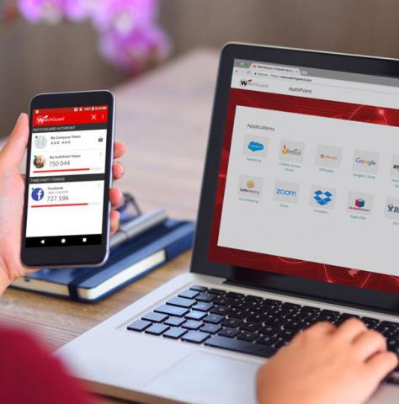
Microsoft Domains (directory services)
Independent software vendors and end-user developers can use Active Directory Domain Services programming to directory-enable their products and applications.
Windows 2000 Server and later operating systems provide a user interface for users and administrators to work with the objects and data in Active Directory Domain Services.
Notes:
Independent software vendors and end-user developers can use Active Directory Domain Services programming to directory-enable their products and applications.
Windows 2000 Server and later operating systems provide a user interface for users and administrators to work with the objects and data in Active Directory Domain Services.

Slide 12

Microsoft Domains (directory services)
Services can publish themselves in Active Directory Domain Services; clients can use Active Directory Domain Services to find services, and both can use Active Directory Domain Services to locate and work with other objects on a network.
Notes:
Services can publish themselves in Active Directory Domain Services; clients can use Active Directory Domain Services to find services, and both can use Active Directory Domain Services to locate and work with other objects on a network.

Slide 13
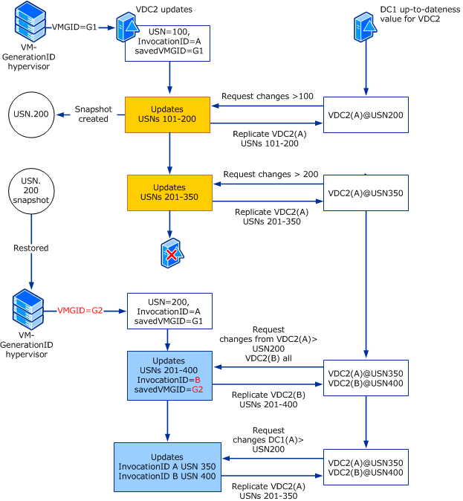
Active Directory services structure
Notes:
Sample structure of AD
The structure of the hierarchy includes an AD forest, the forest's domains and organizational units in those domains. AD DS integrates security by authenticating logons and controlling who has access to directory resources.

Slide 14
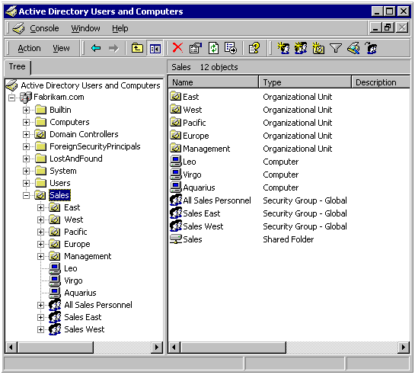
Notes:
Sample outlook of AD

Slide 15

Active Directory services structure
Active Directory stores information about a variety of objects in the network. Importantly, user accounts, computer accounts, groups, and all related credential information used by the Windows implementation of Kerberos are stored in Active Directory.
Notes:
Active Directory stores information about a variety of objects in the network. Importantly, user accounts, computer accounts, groups, and all related credential information used by the Windows implementation of Kerberos are stored in Active Directory.

Slide 16

Active Directory services structure
Active Directory is a directory, basically where information is stored. Usually you will find users account information, credentials, groups, printers and other peripherals, etc. The largest part of the Active Directory is a Domain and the smallest an Object. An object is any user, system, resource or service within AD; so an object can be a user, printer, workstation, etc. Active Directory can track these objects, even if they have the same or similar attributes (for more information, see Microsoft’s TechNet article on Active Directory. Objects are then grouped into Organizational Units (OU).
Notes:
Active Directory is a directory, basically where information is stored. Usually you will find users account information, credentials, groups, printers and other peripherals, etc. The largest part of the Active Directory is a Domain and the smallest an Object. An object is any user, system, resource or service within AD; so an object can be a user, printer, workstation, etc. Active Directory can track these objects, even if they have the same or similar attributes (for more information, see Microsoft’s TechNet article on Active Directory. Objects are then grouped into Organizational Units (OU).

Slide 17

When would you want to use AD
We need Active Directory to make a manageable environment for all the employees as well as for the employer.
You can manage remote sites of your organization without even bothering about the security threats by implementing various trust relationship and rest methods via Active Directory.
Notes:
We need Active Directory to make a manageable environment for all the employees as well as for the employer.
You can manage remote sites of your organization without even bothering about the security threats by implementing various trust relationship and rest methods via Active Directory.

Slide 18
When would you want to use AD
As a Server Administrator, what you can do is. You can tell anyone exactly what they will be doing on their machines.
You can lock them , You can restrict them fro changing the wallpaper, you can give them permission to access a particular file on a file sever, and by doing this all the files will be restricted for them but the one for which they are having permissions will only be available.
Notes:
As a Server Administrator, what you can do is. You can tell anyone exactly what they will be doing on their machines.
You can lock them , You can restrict them fro changing the wallpaper, you can give them permission to access a particular file on a file sever, and by doing this all the files will be restricted for them but the one for which they are having permissions will only be available.

Slide 19

Active Directory Tools (AD DS) to create and manage the directory service structures
The makeup of AD DS includes:
AD Users and Computers
AD Administrative Center
AD Domains and Trusts
AD Sites and Services
AD PowerShell module
A server for Network Information Service tools
Additional command-line tools and snap-ins
Notes:
The makeup of AD DS includes:
AD Users and Computers
AD Administrative Center
AD Domains and Trusts
AD Sites and Services
AD PowerShell module
A server for Network Information Service tools
Additional command-line tools and snap-ins

Slide 20

Active Directory Tools (AD DS) to create and manage the directory service structures
Active Directory Domain Services (AD DS) is a server role in Active Directory that allows admins to manage and store information about resources from a network, as well as application data, in a distributed database. AD DS can also help admins manage a network's elements (computers and end users) and reorder them into a custom hierarchy
Notes:
Active Directory Domain Services (AD DS) is a server role in Active Directory that allows admins to manage and store information about resources from a network, as well as application data, in a distributed database. AD DS can also help admins manage a network's elements (computers and end users) and reorder them into a custom hierarchy

Slide 21
Active Directory Tools (AD DS) to create and manage the directory service structures
A number of new features were added to AD DS when Windows Server 2012 was released. Some of these new features ;
A global catalog with information about all objects in the directory
A replication service to dispense a directory's data across the network
A flexible single master options role to have a consistent directory without conflicting entries.
Notes:
A number of new features were added to AD DS when Windows Server 2012 was released. Some of these new features ;
A global catalog with information about all objects in the directory
A replication service to dispense a directory's data across the network
A flexible single master options role to have a consistent directory without conflicting entries.

Slide 22
Conclusion
The Kerberos protocol defines how clients interact with a network authentication service. Clients obtain tickets from the Kerberos Key Distribution Center (KDC), and they present these tickets to servers when connections are established. Kerberos tickets represent the client's network credentials.
Notes:
The Kerberos protocol defines how clients interact with a network authentication service. Clients obtain tickets from the Kerberos Key Distribution Center (KDC), and they present these tickets to servers when connections are established. Kerberos tickets represent the client's network credentials.

Slide 23
Conclusion
The Kerberos protocol assumes that transactions between clients and servers take place on an open network where most clients and many servers are not physically secure, and packets traveling along the network can be monitored and modified at will. The assumed environment is like today's Internet where an attacker can easily pose as either a client or a server, and can readily eavesdrop on or tamper with communications between legitimate clients and servers
Notes:
The Kerberos protocol assumes that transactions between clients and servers take place on an open network where most clients and many servers are not physically secure, and packets traveling along the network can be monitored and modified at will. The assumed environment is like today's Internet where an attacker can easily pose as either a client or a server, and can readily eavesdrop on or tamper with communications between legitimate clients and servers

Slide 24
References
Hickie, T. W. (2012). U.S. Patent No. 8,275,356. Washington, DC: U.S. Patent and Trademark Office.
Chawla, D., & Beckett III, W. R. (2015). U.S. Patent No. 9,021,251. Washington, DC: U.S. Patent and Trademark Office.
Shahbazi, M. (2013). U.S. Patent No. 8,495,700. Washington, DC: U.S. Patent and Trademark Office.
Orr, D. B., Ptacek, T. H., & Song, D. J. (2012). U.S. Patent No. 8,146,160. Washington, DC: U.S. Patent and Trademark Office.
Subashini, S., & Kavitha, V. (2011). A survey on security issues in service delivery models of cloud computing. Journal of network and computer applications, 34(1), 1-11.

